Slide 1
Leads Score Case Study
Submitted by
Nayantara Singh
(My entire group was absent and did not help as they were busy with prior engagements).
I request you to kindly consider that I have been working on this project very hard and my marks should not suffer because of others

Slide 2
PROBLEM STATEMENT
◤
X Education is an education company that offers online courses to professionals in various industries.
The company markets its courses on multiple websites and search engines like Google to attract potential customers.
When people visit the X Education website, they may browse courses, fill out a form, or watch
videos.
Those who fill out a form providing their email or phone number are classified as leads, which the sales team follows up on to convert them into customers.
The company's typical lead conversion rate is approximately 30%, meaning only about 30 out
of 100 leads are converted into paying customers.
X Education aims to increase its lead conversion rate by identifying the most promising leads, also known as "Hot Leads."
By focusing more on communicating with the most promising leads, the company believes it
can improve its lead conversion rate and make the process more efficient.

Slide 3
OBJECTIVE
◤
X Education aims to identify the most promising leads for their business.
To achieve this goal, they plan to develop a machine learning model.
This model will help identify "hot" leads, or those with a high probability of conversion.
Once developed, the model will be deployed for future use.
This will enable X Education to focus their resources and efforts on leads that are most likely to generate revenue.

Slide 4
APPROACH USED
◤
1. Duplicate data handling: Check for duplicate data in the dataset and remove them to avoid errors in the analysis.
Handling of missing values: Check for missing values and handle them using appropriate techniques like dropping or imputing values.
Column dropping: If a column contains a large number of missing values and is not useful for analysis, drop the column.
Imputation: If necessary, impute missing values using appropriate techniques.
Outlier handling: Identify and handle outliers in the dataset using techniques like 1% Winsorization or removal.
Univariate data analysis: Analyze variables individually using techniques like value count and distribution.
Feature scaling: Scale the data to a common scale for better analysis.
Dummy variables and encoding: Convert categorical data to numerical data using dummy variables and encoding.
Logistic regression: Use logistic regression as a classification technique to make predictions based on the data.
Validation of the model.
Model presentation: Present the results and conclusions of the analysis based on the model.
Conclusion and recommendations: Draw conclusions and make recommendations based on the analysis and the results of
the model.

Slide 5
DATA PREPARATION
◤
Initially, we identified redundant variables and removed them from the dataset.
We converted the "Select" variable to null values, as it represented the absence of data entry.
We then checked the percentage of null values present in each column and
dropped any columns that had more than 45% null values.
To address the null values in the dataset, we also removed some rows.
Overall, these steps helped to clean and prepare the dataset for further
analysis.

Slide 6
EXPLORATORY DATA ANALYSIS
◤
To assess the quality of our data, we performed an exploratory data analysis (EDA).
During the EDA, we found that several elements in the categorical variables were insignificant.
We also observed outliers in the "TOTALVISITS" variable.
To address the outliers, we removed the top 1% and bottom 1% of values from the column.
By handling the outliers and other issues identified during the EDA, we improved the overall quality of the dataset.
This helped ensure that any subsequent analysis or modeling efforts would be based on reliable data.

Slide 7
OUTLIER ANALYSIS
◤
We dealt with outliers in the “Totalvisits” column
using 1% Winsorization technique.
It means we dealt with it by removing top and bottom 1% of the values from the “Totalvisits” column.

Slide 8
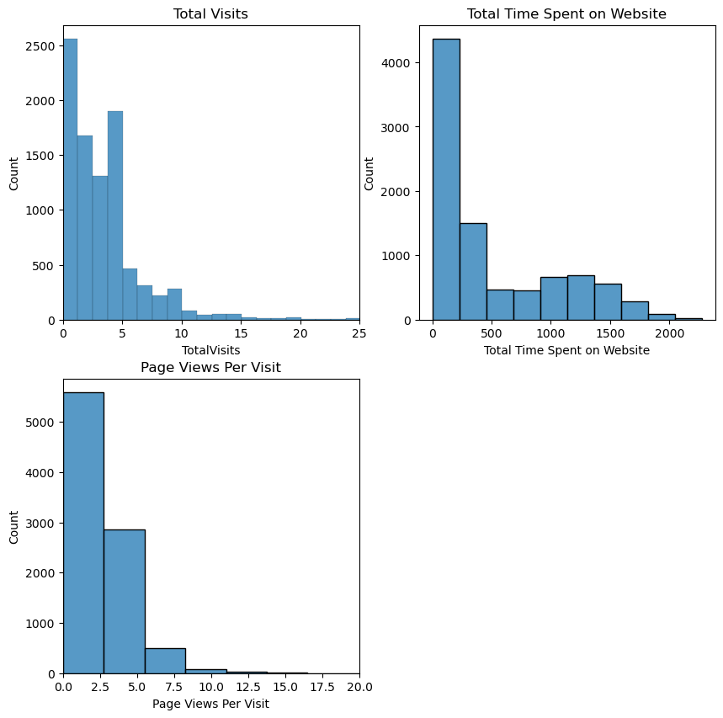
◤NUMERICAL VARIABLE ANALYSIS

Slide 9
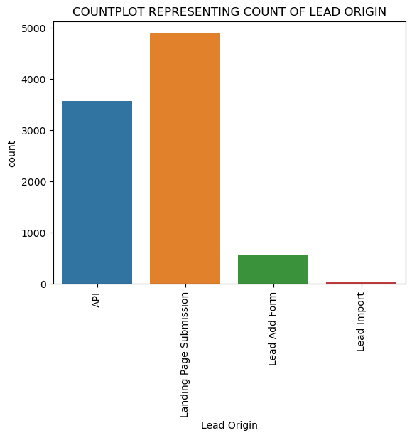
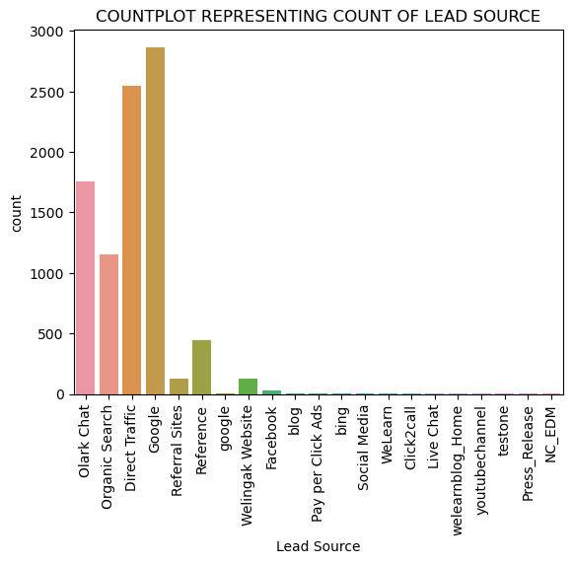
CATEGORICAL VARIABLE ANALYSIS
◤

Slide 10
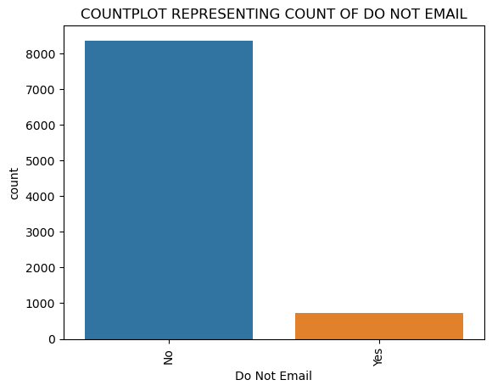
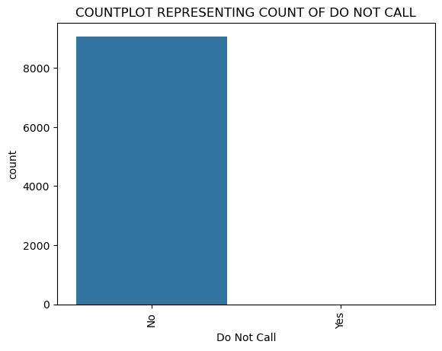
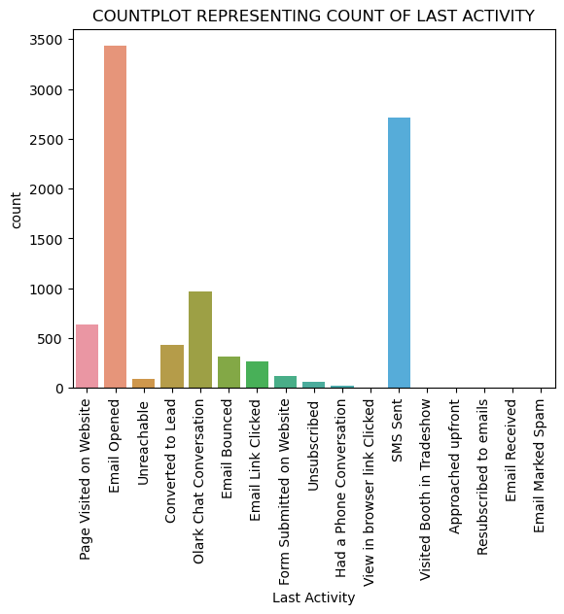
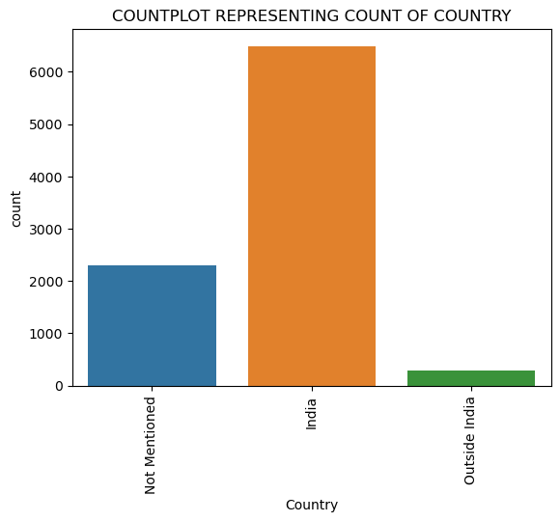
◤

Slide 11
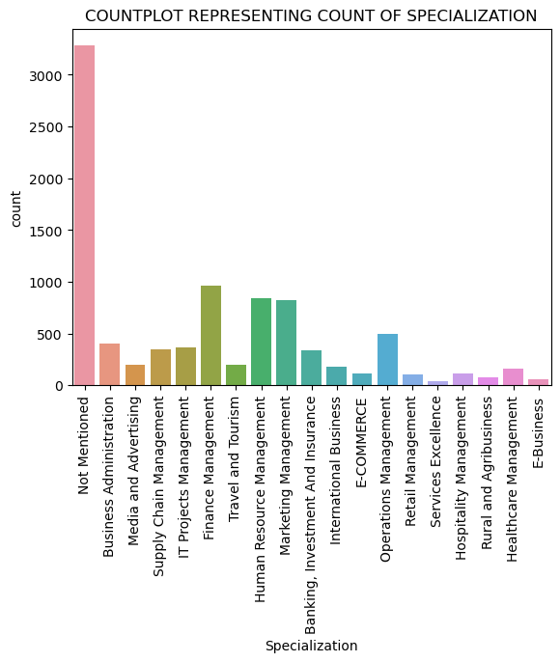
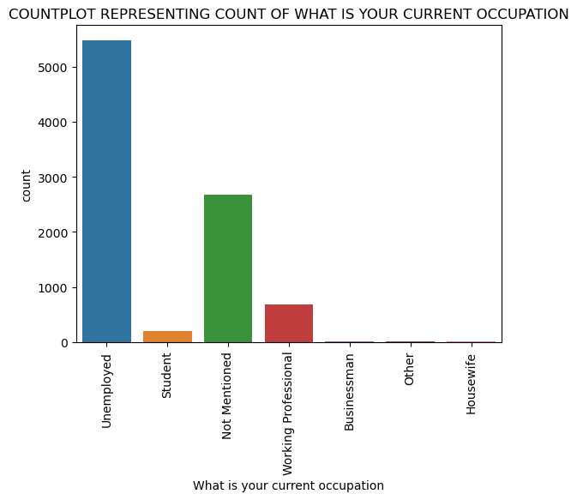
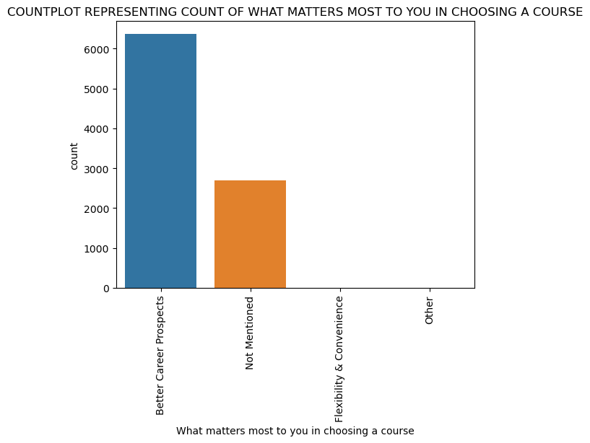
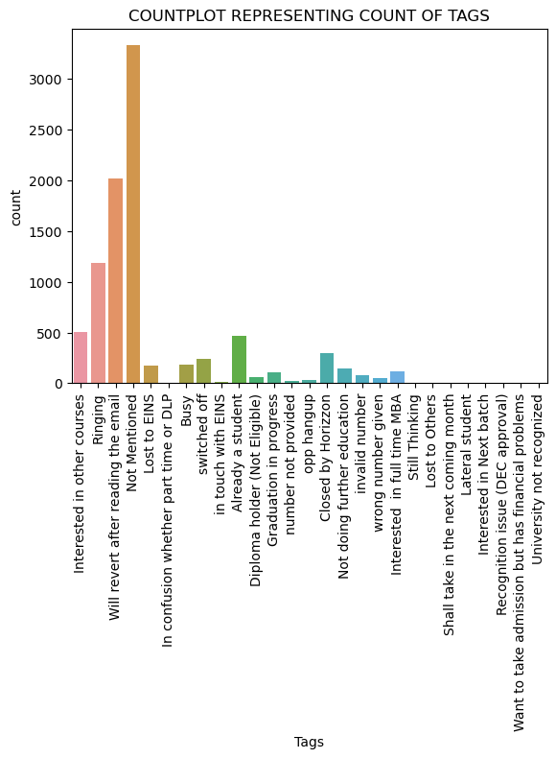
◤

Slide 12
MODEL BUILDING
◤
Two machine learning models were built.
The first step was to use Recursive Feature Elimination (RFE) to select the 15 most relevant variables.
Variables were dropped based on their p-value and VIF score.
A threshold of 5 was chosen for VIF score and 0.05 for p- value.

Slide 13
MODEL EVALUATION
◤
A confusion matrix was created to evaluate the classification model.
The goal was to find the best cut-off point to balance the sensitivity and specificity of the model.
The optimal cut-off point was found to be 0.35.
After determining the optimal cut-off point, the accuracy, specificity, and sensitivity of the model were checked on the test set.
The accuracy, specificity, and sensitivity were approximately 80%, 81%, and 81%, respectively.

Slide 14
PRECISION AND RECALL
◤
A precision-recall curve was plotted to evaluate the performance of the classification model.
An optimal cut-off point of 0.42 was determined from the curve.
After setting the cut-off point to 0.42, predictions were made on the test dataset.
The precision and recall values of the model were found to be 74% and 76%, respectively.

Slide 15
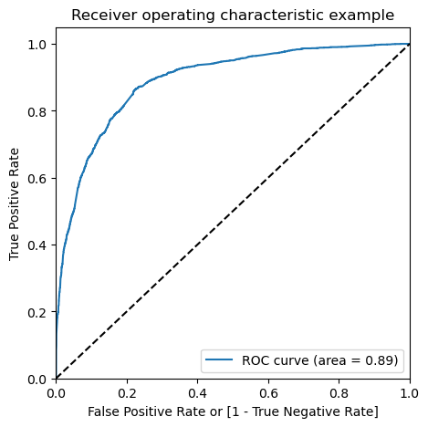
ROC CURVE
◤

Slide 16
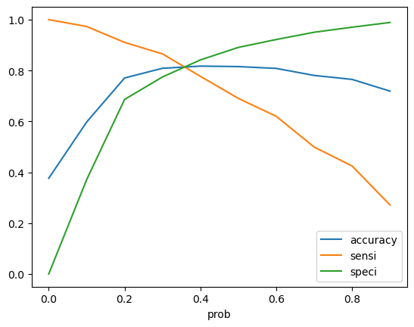
OPTIMAL CUTOFF POINT
◤
From the curve above we can infer 0.35 is the optimum point to take it as a
cutoff probability
This is an optimal cut off point i.e., a point where we get balanced sensitivity and specificity.

Slide 17
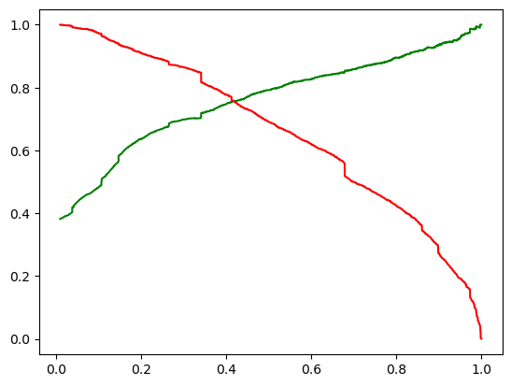
PRECISION RECALL CURVE
◤
Precision and recall curve suggests us to set a cut of 0.42 which we used in later parts of our analysis.

Slide 18
FINDINGS AND RECOMMENDATIONS
The variabl◤es that are most significant in determining whether a lead is a potential buyer or not are listed below.
Factors that have positive impact in converting the lead :
Total Time Spent on Website.
If the lead is a Working Professional.
If the lead had a Phone Conversation with the sales team.
The lead source was:
Welingak Website
Reference
At the same time customers falling under below mentioned category are less likely to convert :
Who have said don’t email them.
With whom last conversation was through Olark chat.
When the client has not mentioned “What matters you the most” when choosing a
particular course.

Slide 19
THANK YOU
◤

